Slide 1
A Mixed-Criticality MPSoC Case-Study
The Multi-Rotor Avionics and Payload Computer System
Sören Schreiner, M.Sc. – OFFIS e.V.

Slide 2
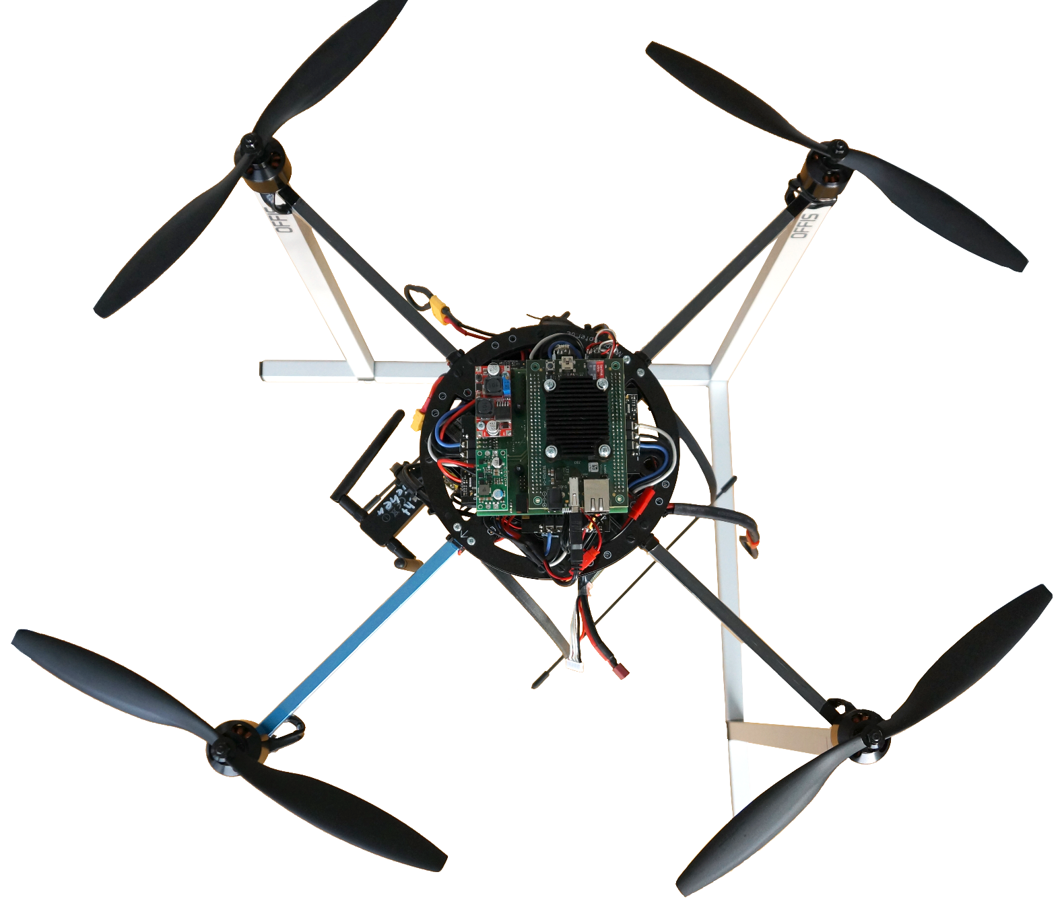
Multi-rotor system demonstrator
Rapidly rotating Propellers
!!! SAFETY-CRITICAL SYSTEM !!!
~ 60cm Aluminium/Carbon Frame
~ 2.4kg
~ 60km/h
Notes:
Motivation:
Kopter als fliegende Plattform, die allerdings trotz der kleinen größe sicherheitskritiisch ist
Können Nutzlast mitnehmen
Bisher onboard processing durch weitere hardware, die augf dem kopter mitgeführt wird
Mit CONTREX die einführung von mixed criticality
Payload Processing und flight algorithms auf einem single chip

Slide 3
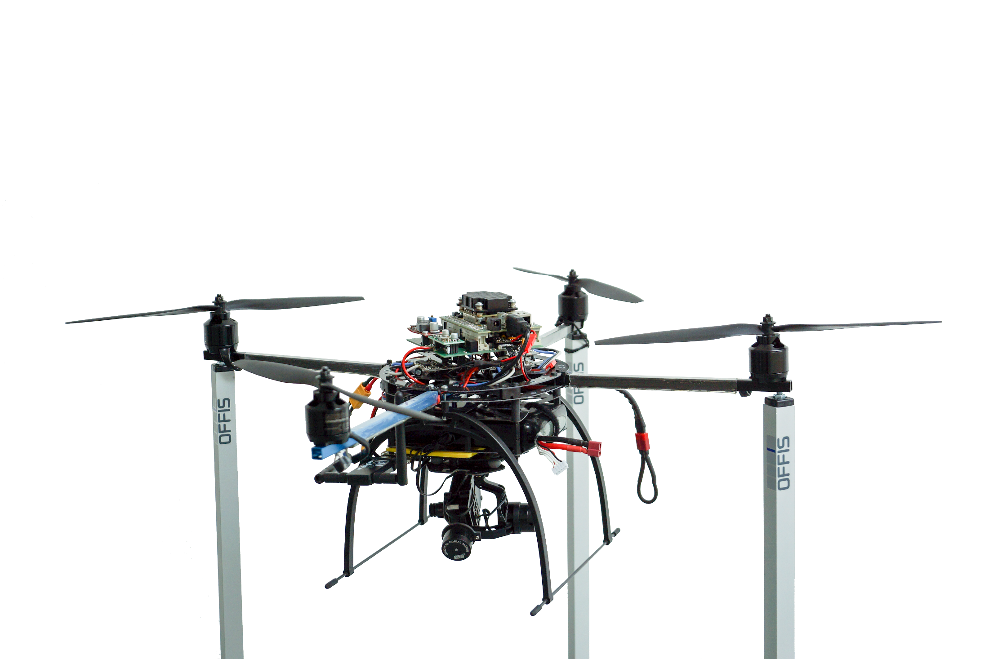

Multi-rotor system demonstrator
Avionics based on Xilinx Zynq 7020 MPSoC
Avionics developed and assembled by Students of the University of Oldenburg
in their master‘s project group
Avionics Battery
Motor Battery
HD Camera mounted on
3 Axis Gimbal

Slide 4
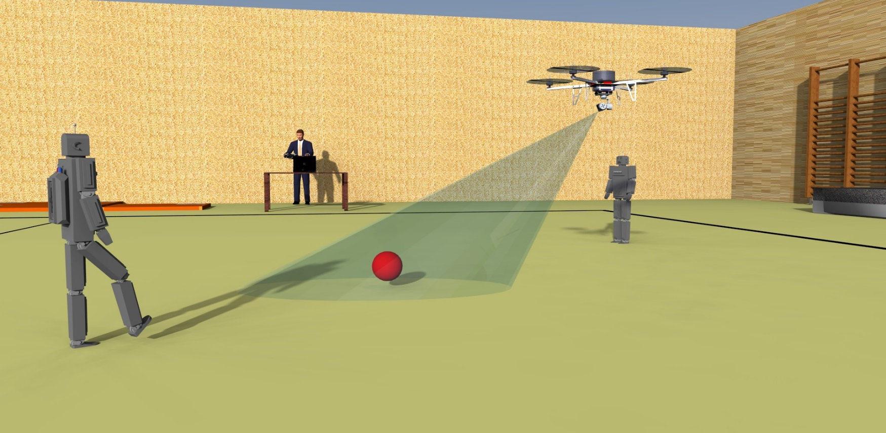
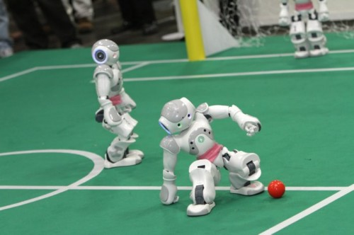
Multi-rotor system‘s mixed-critical use-case
Shoot robo soccer games with on-board camera
Use of a single chip avionics based on Zynq 7020
Two main tasks:
1. Flight algorithms (safety-critical)
2. On-board video processing (non-/mission-critical)
Source: www.robocup2010.org

Slide 5
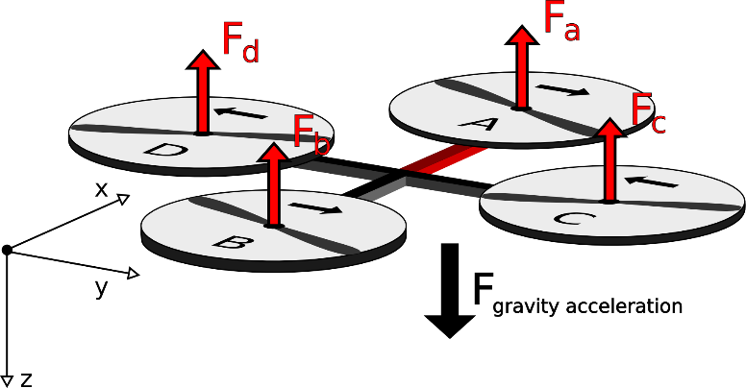
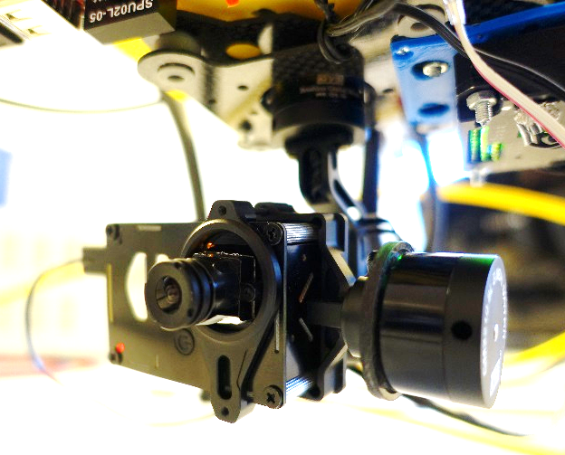
Task description
Safety-critical flight algorithms
Sensor processing
Remote control processing
Attitude and altitude controller (standard PID)
Failure → System will crash
Non-/Mission-critical object detection
Video grabbing from camera
Object detection
Adjustment of camera gimbal to follow object
Failure → Quality of Service
Safety-critical task has to be separated by the architecture to avoid all influences through other tasks

Slide 6




State-of-the-art mixed-critical system design
Fully distributed with dedicated HW/SW platforms for different criticalities
Safety-critical flight algorithms
Non-/Mission-critical object detection
F1
F2
F3
F4
F5
CPU
Memory
HW IP
...
CPU
Memory
HW IP
...
F1
F2
F4
F3
t
F5
t
d_{2->3}
d_{4->5}
Application 1
Hard deadline d_{2->3}
No power constraint
No temperature constraint
Application 2
Soft deadline d_{4->5}
Hard power constraint
Hard temperature constraint
Extra-functional properties Timing, Power & Temperature

Slide 7




Mixed-critical system design
Temporal, spatial, power and temperature segregation for mixed-critical control applications
Safety-critical flight algorithms
Non-/Mission-critical object detection
F1
F2
F3
F4
F5
CPU
Memory
HW IP
...
CPU
Memory
HW IP
...
<<virtual>>
<<virtual>>
<<virtual>>
<<virtual>>
<<virtual>>
<<virtual>>
F1
F2
F4
F3
t
F5
t
d_{2->3}
d_{4->5}
F1
Multi-core architecture
running
CPU 1
CPU 2
Memory
HW IP
...
F2
block/susp.
F3
shared var.
F4
F5
comm.
t
d_{2->3}
d_{4->5}

Slide 8
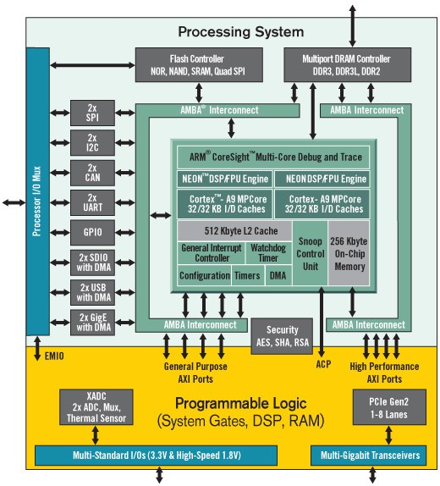
Xilinx Zynq 7020 overview
Processing System
Dual ARM Cortex A9
866MHz
Standard interfaces available
Programmable Logic
Implementing own or IP hardware (further needed interfaces, processing elements, etc.)
85.000 Logic Cells
Great for exploring architectures for mixed-criticality systems in consideration of extra-functional properties
(Near future: Zynq UltraScale+)
Source: www.xilinx.com

Slide 9
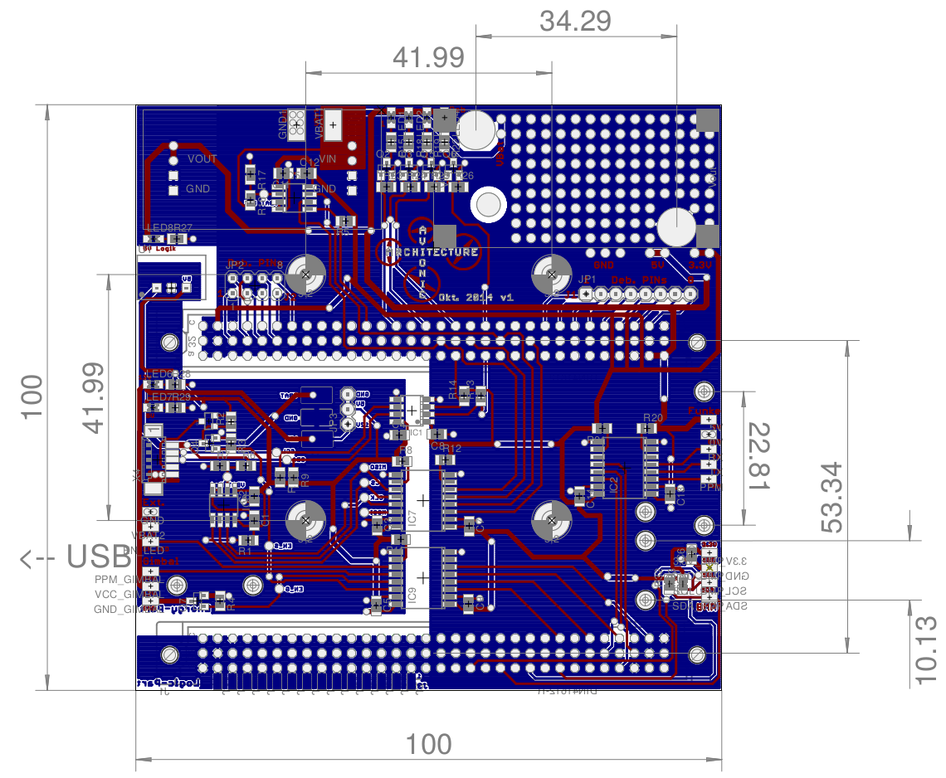
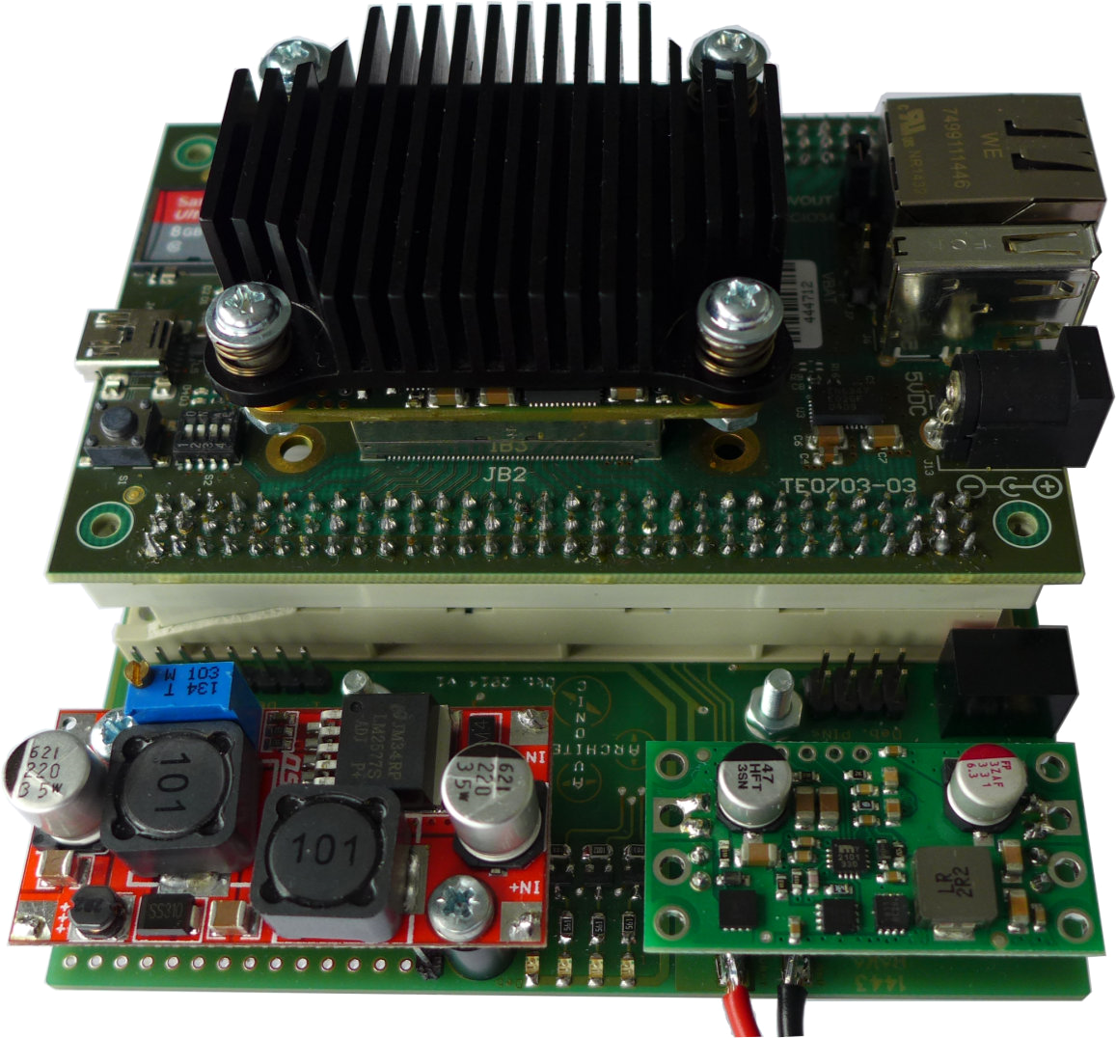
Avionics HW-architecture top-down
Zynq industry board mounted on top of avionics
Distribution board allows
Direct connection to sensors (accelerometers, gyroscopes, magnetometer, barometer)
Direct connection to motor drivers
Etc.
Separation in two power domains (motor & avionics)
Since motors introduce much noise on the power lines
Avoid failure of Zynq
Mission-Critical Part
ARM9 MP Cortex
Camera
Gimbal
Wi-Fi
SD-Card
DDR-RAM
A9 Core 0
A9 Core 1
L1 Cache
L1 Cache
USB
SDIO
DDR
L2 Cache
Debug Pins
GPIO
AMBA Interconnect
Safety-Critical Part
Debug Pins
Programming Logic
GPIO
GPIO
UART IP
DPRAM 1
RC Receiver
GPIO
PPM IP
MPU9150
I2C IP
AXI Bus
DPRAM 0
AXI Bus
GPIO
BMP085
PPM decoding IP core
MicroBlaze 0
Data Mining
MicroBlaze 1
Flight Control
I2C IP
GPIO
I2C IP
Battery Guards
GPIO
SPI IP
I/D RAM
I/D RAM
GPIO
Motor Drivers
Motor Power Domain
Avionics Power Domain

Slide 10
SW-Mapping
Non-/Mission-critical part
Safety-critical part
<<component>>
Video Processing
<<component>>
Data Mining
<<component>>
Flight Control
<<alloc>>
<<alloc>>
<<alloc>>
<<OS>>
Linux kernel
Bare Metal
Bare Metal
<<HW resource>>
ARM9 MP Cortex
<<HW resource>>
Programming Logic
<<alloc>>
<<alloc>>
<<processing resource>>
A9 Core 0
<<processing resource>>
A9 Core 1
<<processing resource>>
MicroBlaze 0
<<processing resource>>
MicroBlaze 1

Slide 11
That‘s all…
Thank you! Any questions?
soeren.schreiner@offis.de

